Slide 1

MedAssist AI
🏥 AI-Powered Healthcare Assistance Platform
INFOSYS SPRINGBOARD INTERNSHIP
Presented by:
Hemanth Karumanchi
B.Tech – CSE
Milestone 1

Slide 2
Objectives
Secure Authentication
Role based access for Patients & Caretakers
AI Disease Prediction
Symptoms-based disease prediction
Digital Medical Reports
Secure report management
Caretaker Assignment
Patient-caretaker collaboration
Centralized Healthcare Management
Unified healthcare platform
Patient
Register/Login
Create Profile
Enter Symptoms
AI Prediction
Recommendations
Upload Reports
Assign Caretaker
Caretaker Dashboard

Slide 3
Technology Stack & System Architecture
Application Workflow
Users authenticate securely using JWT.
React frontend sends API requests to FastAPI.
FastAPI validates requests and executes business logic.
SQLAlchemy manages database interactions with PostgreSQL.
AI prediction service analyzes symptoms.
Results are returned to the frontend in real time.
Frontend
React Vite React Router CSS
Backend
FastAPI REST APIs Pydantic
Database
PostgreSQL SQLAlchemy ORM
Security
JWT RBAC

Slide 4
Database Design
Users
Authentication
Role (Patient/Caretaker)
Patient Profile
Patient Information
Caretaker Profile
Professional Information
The PostgreSQL database is designed to securely manage authentication, patient information, AI prediction records, medical reports, and caretaker assignments while maintaining data integrity through relational table design.
Symptoms
Patient Symptoms
PostgreSQL
Predictions
AI Disease Predictions
Medical Reports
Uploaded Files
Caretaker Assignments
Patient-Caretaker Mapping
Recommendations
Healthcare Advice

Slide 5
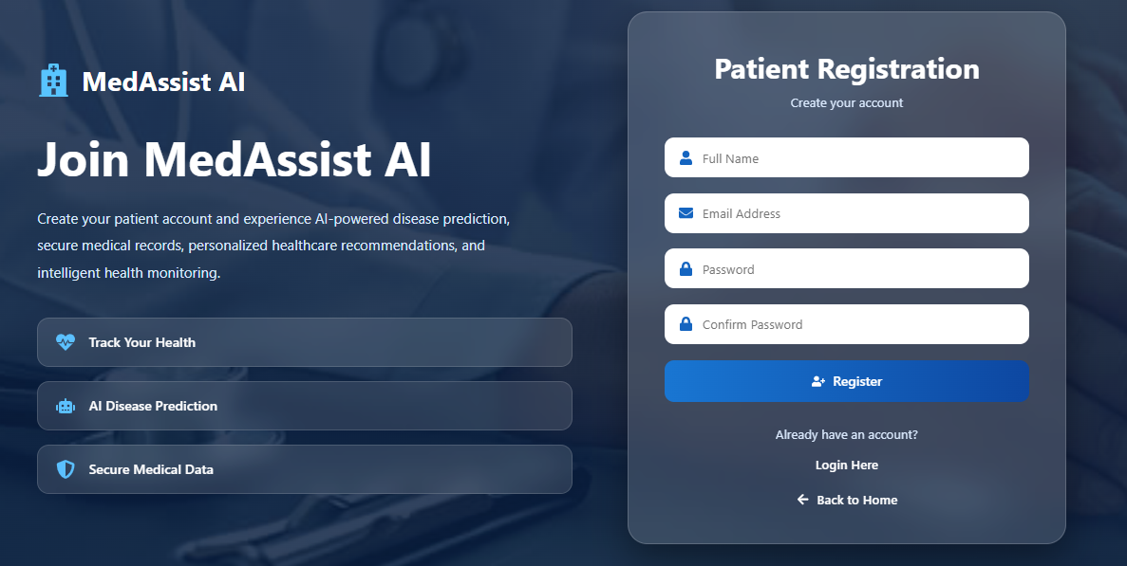
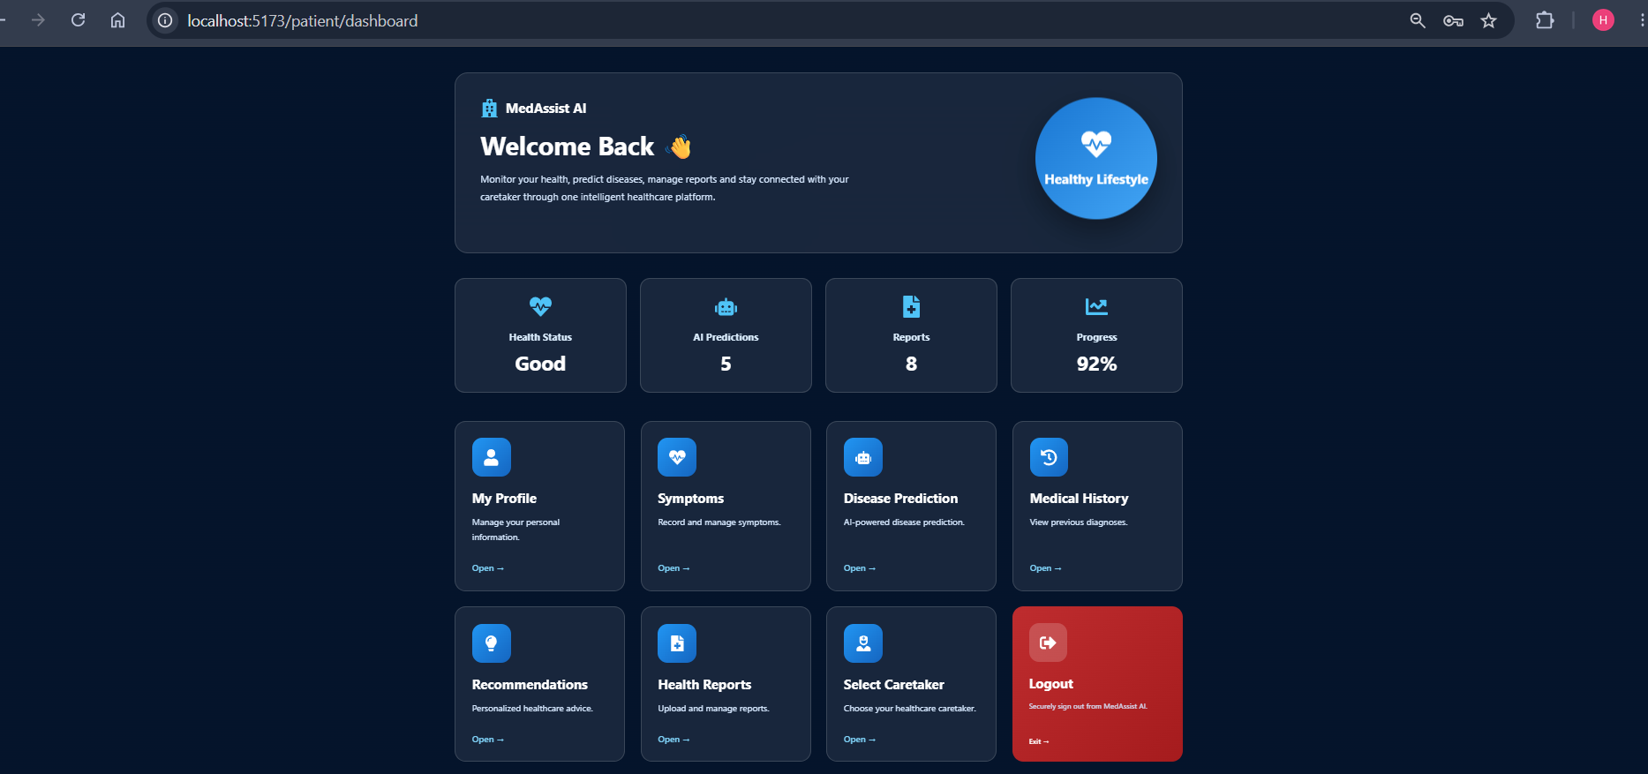
Milestone 1 Progress
Authentication
Login
Registration
JWT Authentication
Patient Module
Dashboard
Profile
Symptoms
Disease Prediction
Recommendations
Health Reports
Caretaker Selection

Slide 6
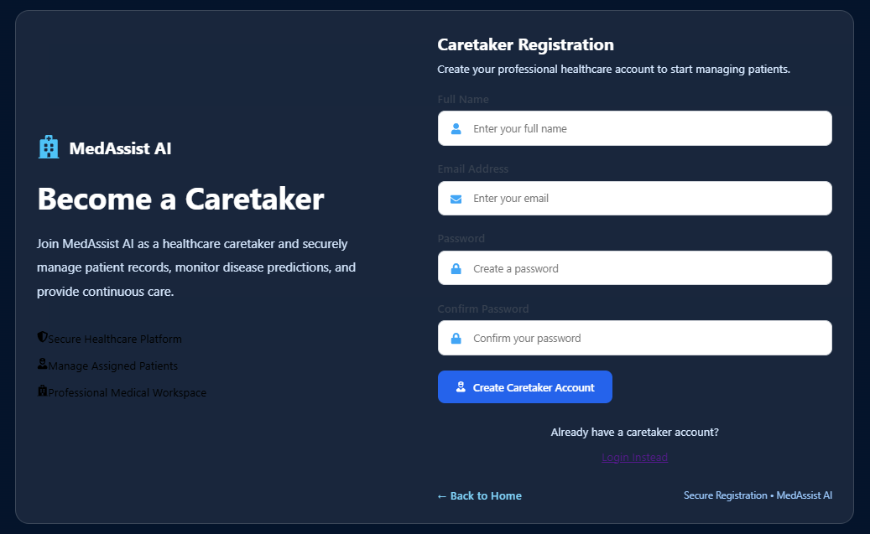
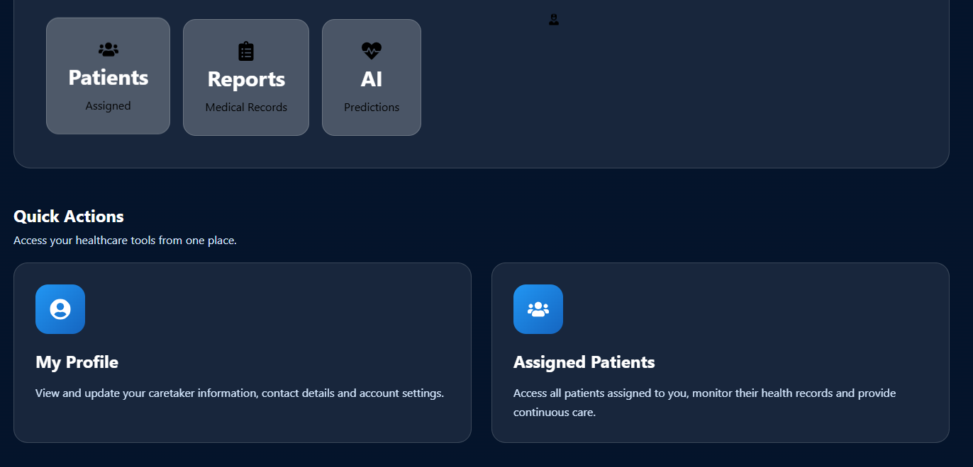
Milestone 1 Progress
Caretaker Module
Dashboard
Profile
Assigned Patients
Patient Details

Slide 7
Future Scope (Milestone 2)
🔹 AI Enhancement
Improve disease prediction accuracy
Expand the medical dataset
🔹 Feature Development
Doctor Portal
Appointment Scheduling
Real-time Notifications
🔹 System Improvements
Responsive UI & UX
Enhanced Security
Cloud Deployment
Milestone 1
│
▼
AI Enhancement
│
▼
Feature Development
│
▼
System Improvements
│
▼
Deployment
Goal: Transform MedAssist AI into a secure, scalable, and production-ready healthcare platform.

